Slide 1
Secant Method
by Dr. Md. Rajibul Islam CSE, UAP
*
‹#›

Slide 2
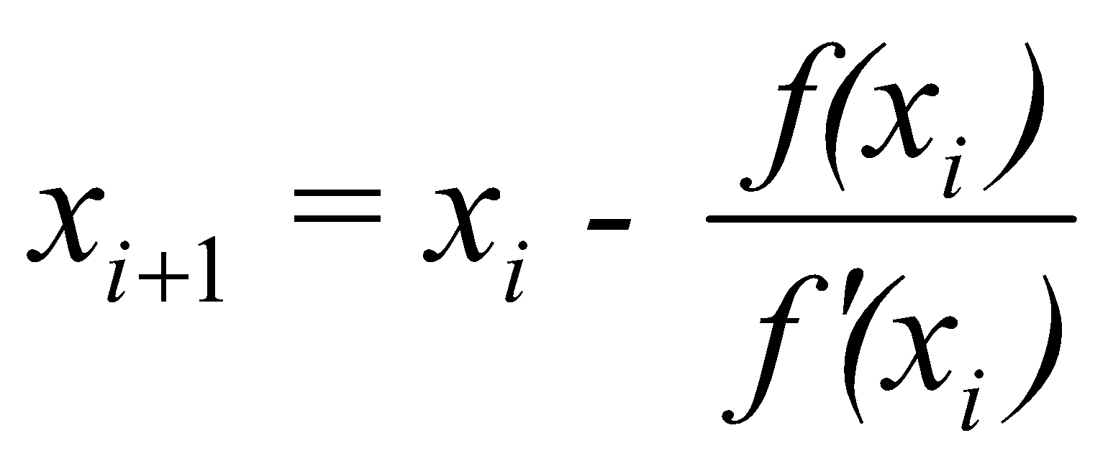
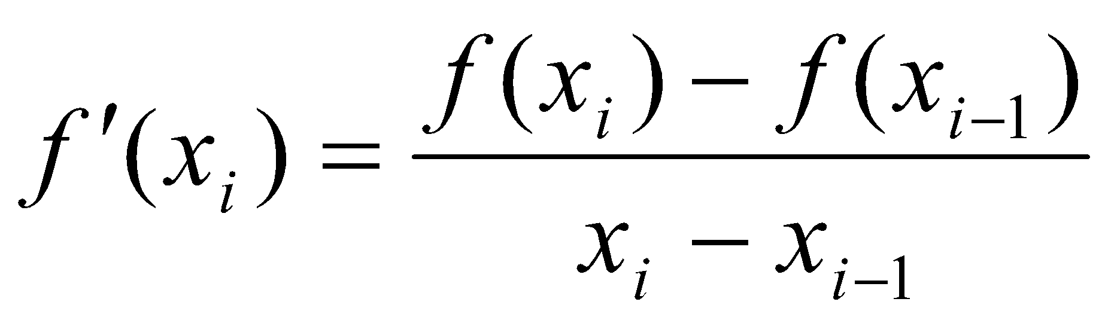
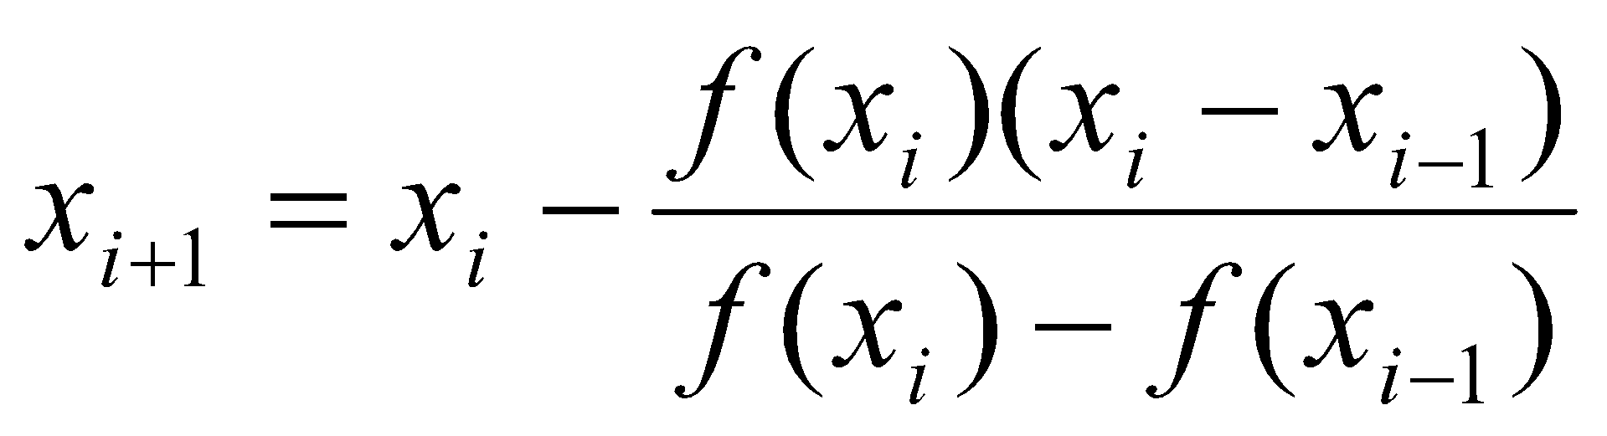
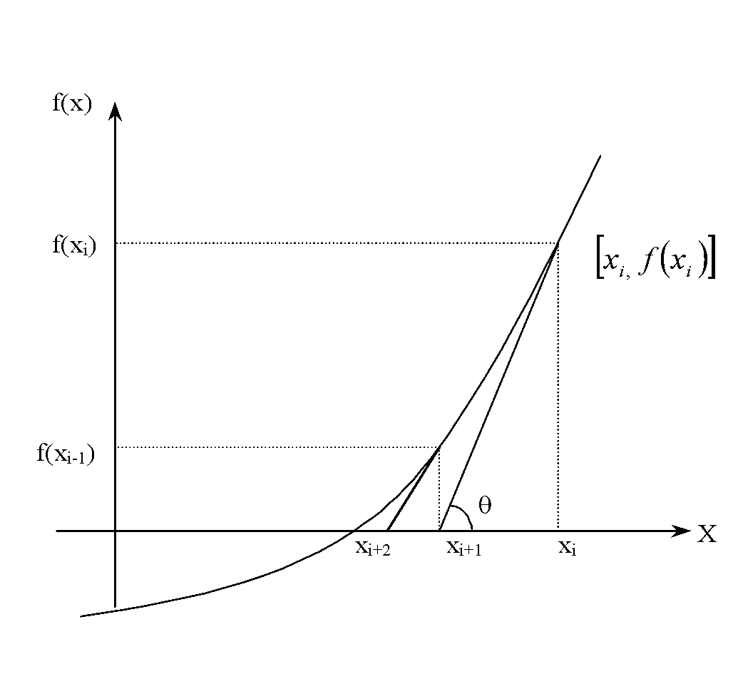
Secant Method – Derivation
Newton’s Method
(1)
Approximate the derivative
(2)
Substituting Equation (2) into Equation (1) gives the Secant method
Figure 1 Geometrical illustration of the Newton-Raphson method.
Backward divided difference formula which leaves 2 unknown variables
‹#›

Slide 3
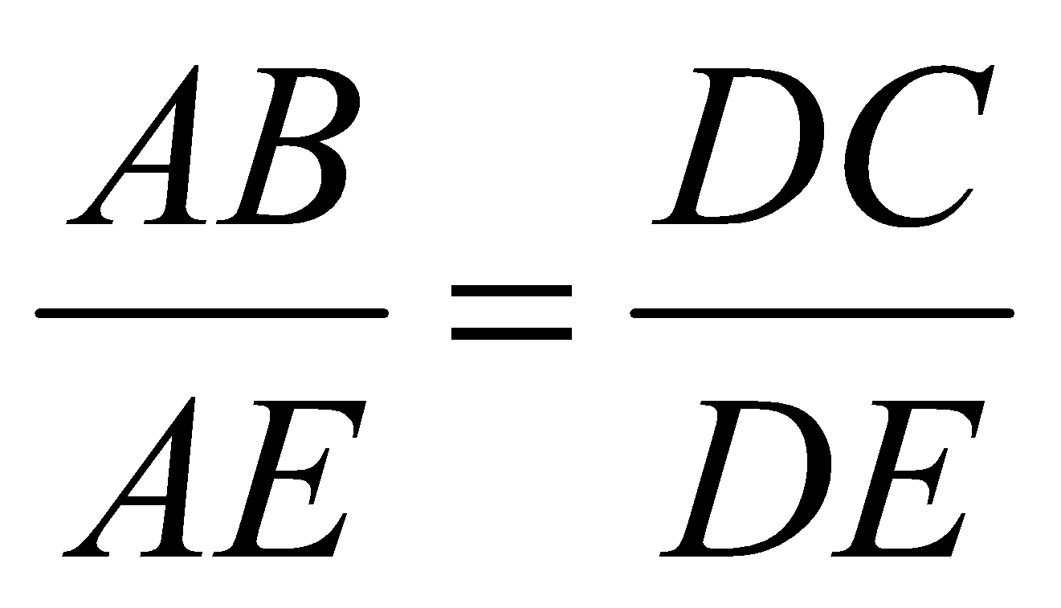
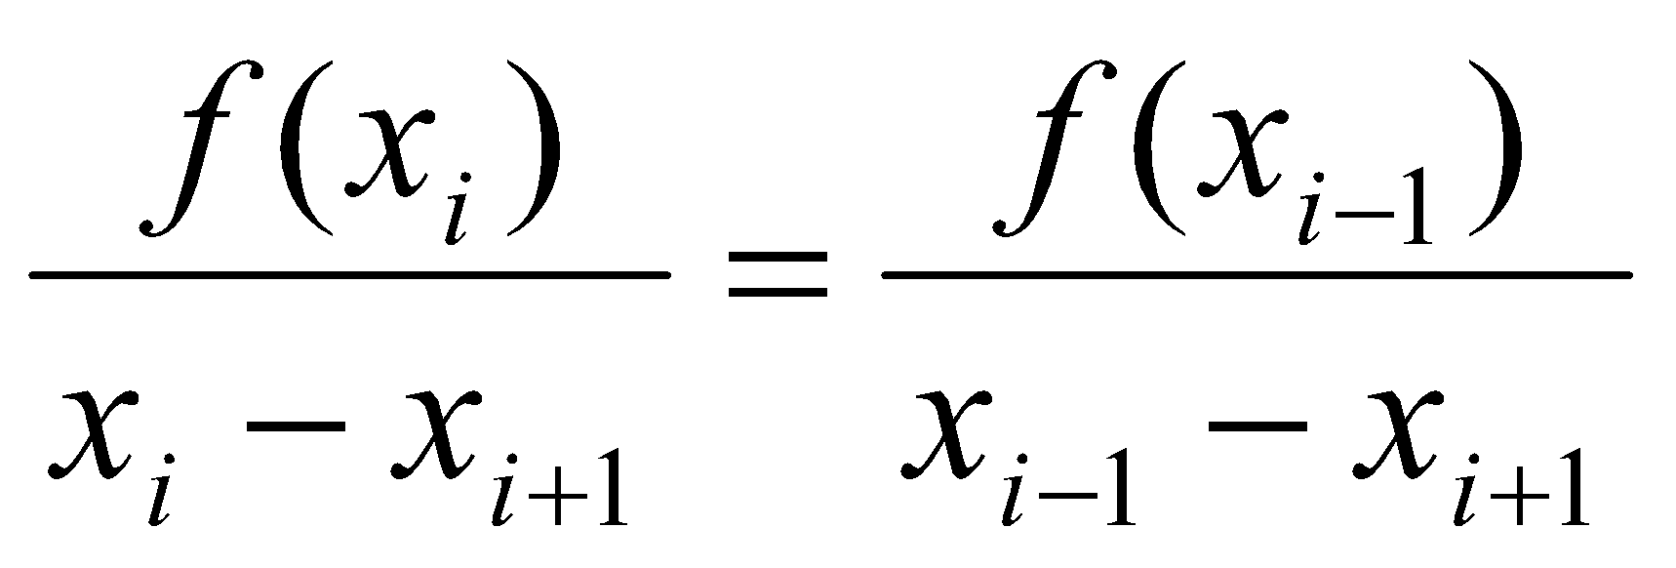
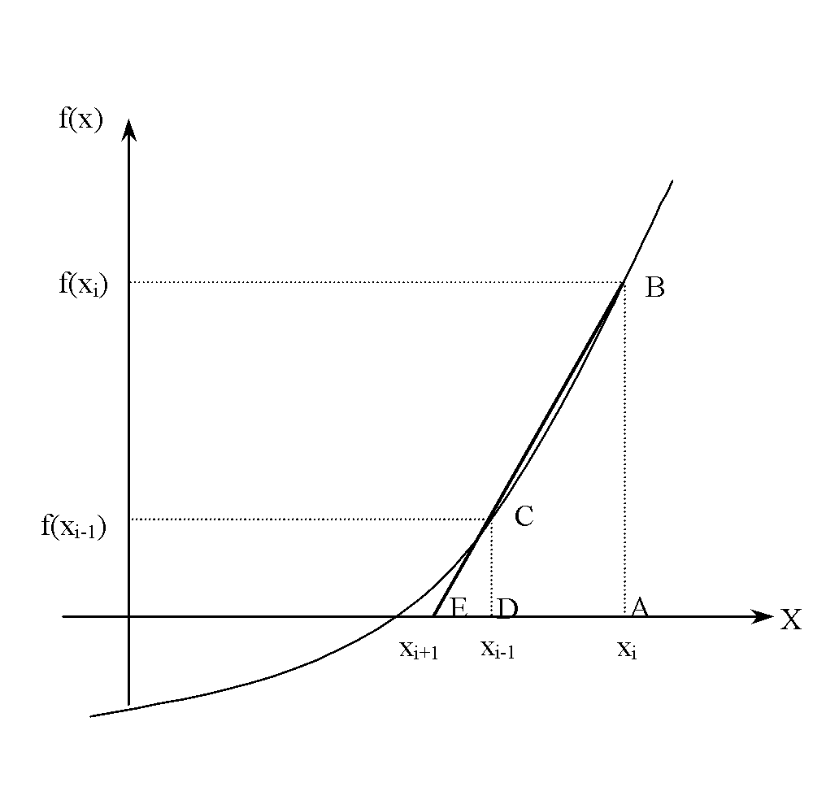
Secant Method – Derivation
The secant method can also be derived from geometry:
The Geometric Similar Triangles
can be written as
On rearranging, the secant method is given as
Figure 2 Geometrical representation of the Secant method.
‹#›

Slide 4
Algorithm for Secant Method
‹#›

Slide 5
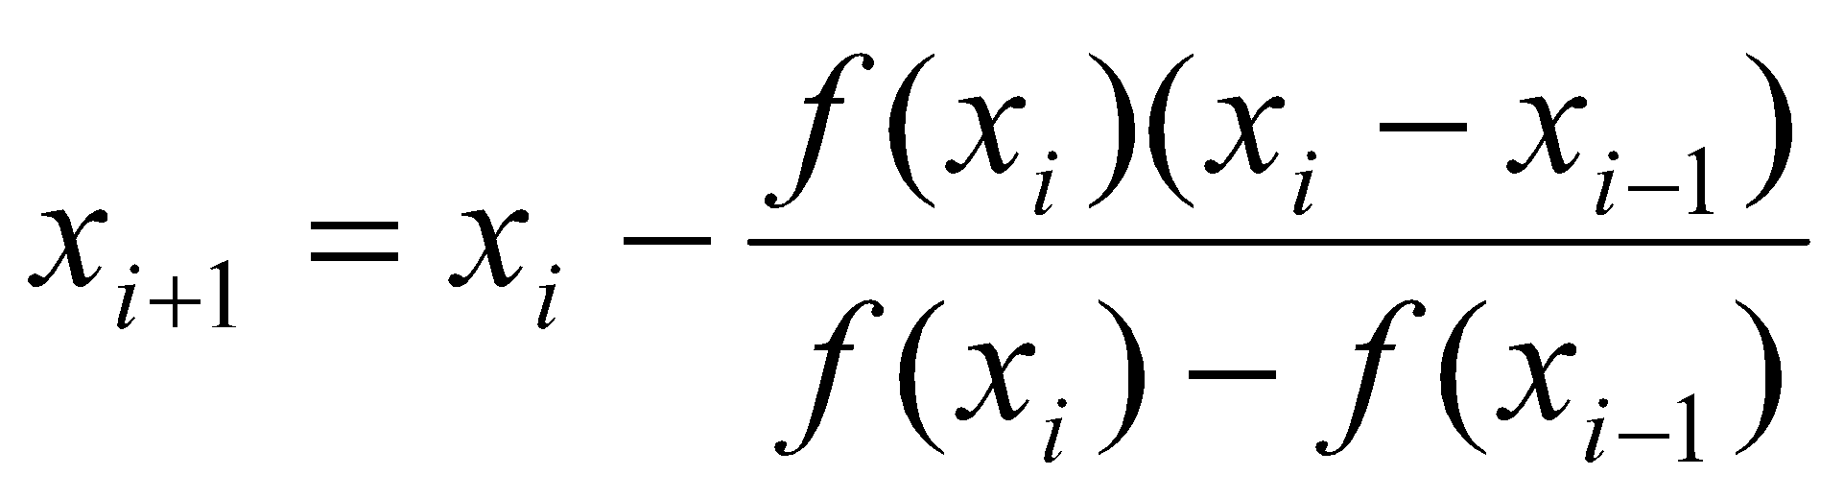
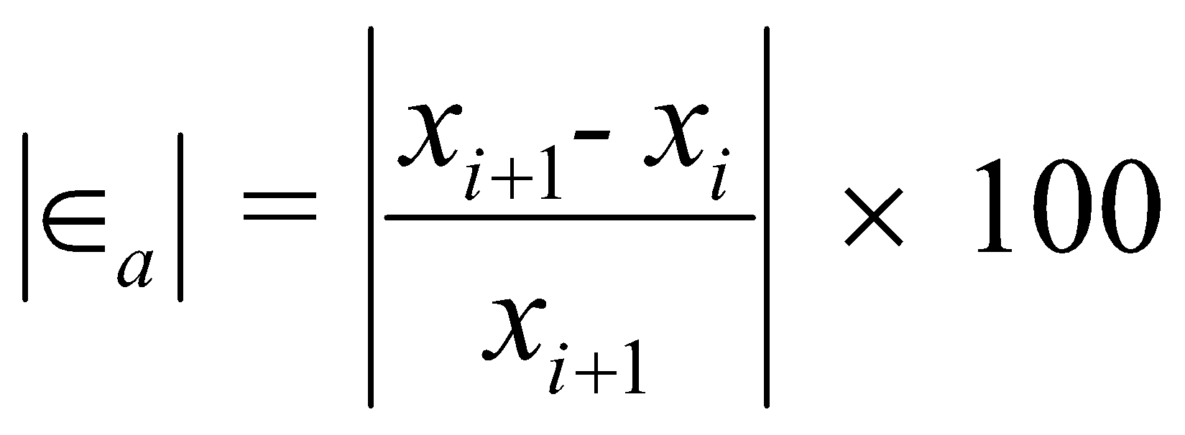
Step 1
Calculate the next estimate of the root from two initial guesses
Find the absolute relative approximate error
‹#›

Slide 6
Step 2
Find if the absolute relative approximate error is greater than the prespecified relative error tolerance.
If so, go back to step 1, else stop the algorithm.
Also check if the number of iterations has exceeded the maximum number of iterations.
‹#›

Slide 7
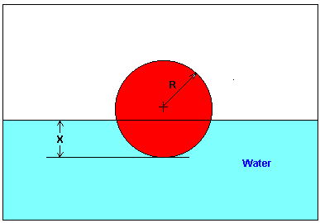
Example 1
You are working for ‘DOWN THE TOILET COMPANY’ that makes floats for ABC commodes. The floating ball has a specific gravity of 0.6 and has a radius of 5.5 cm. You are asked to find the depth to which the ball is submerged when floating in water.
Figure 3 Floating Ball Problem.
‹#›

Slide 8
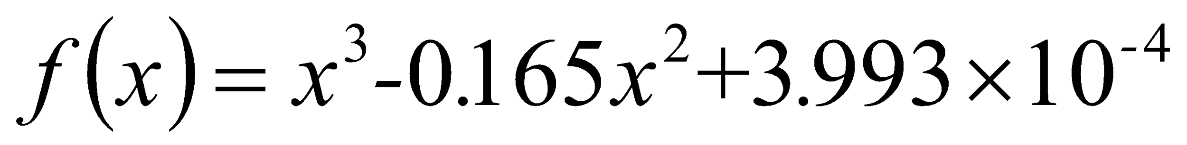
Example 1 Cont.
The equation that gives the depth x to which the ball is submerged under water is given by
Use the Secant method of finding roots of equations to find the depth x to which the ball is submerged under water.
Conduct three iterations to estimate the root of the above equation.
Find the absolute relative approximate error and the number of significant digits at least correct at the end of each iteration.
‹#›

Slide 9
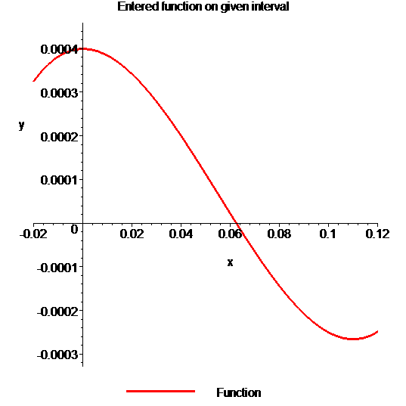

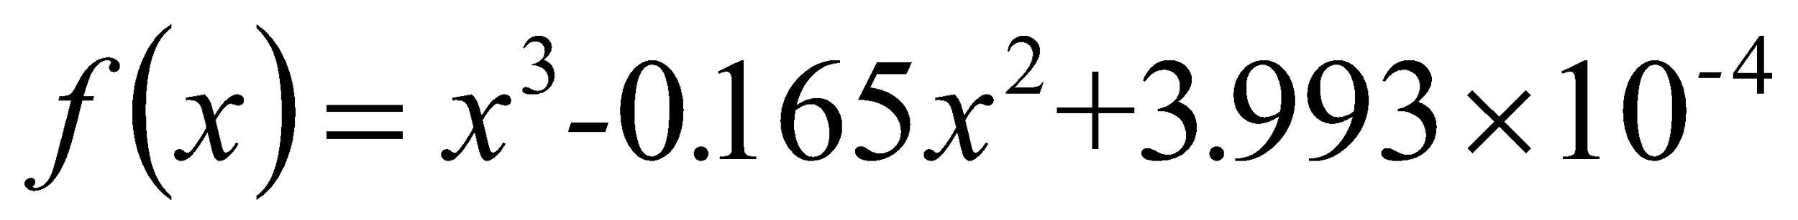
Example 1 Cont.
Solution
To aid in the understanding of how this method works to find the root of an equation, the graph of f(x) is shown to the right,
where
Figure 4 Graph of the function f(x).
‹#›

Slide 10
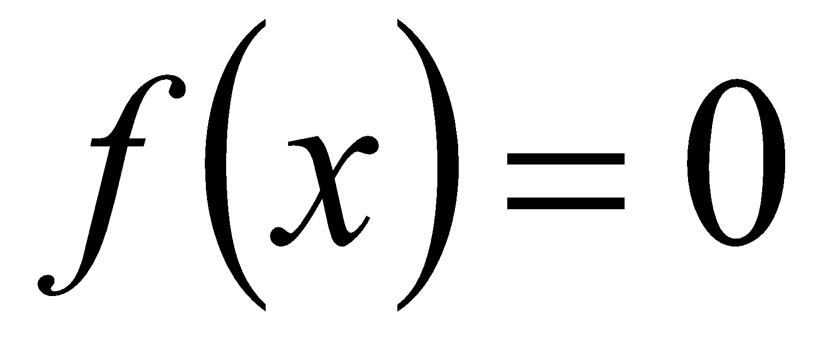
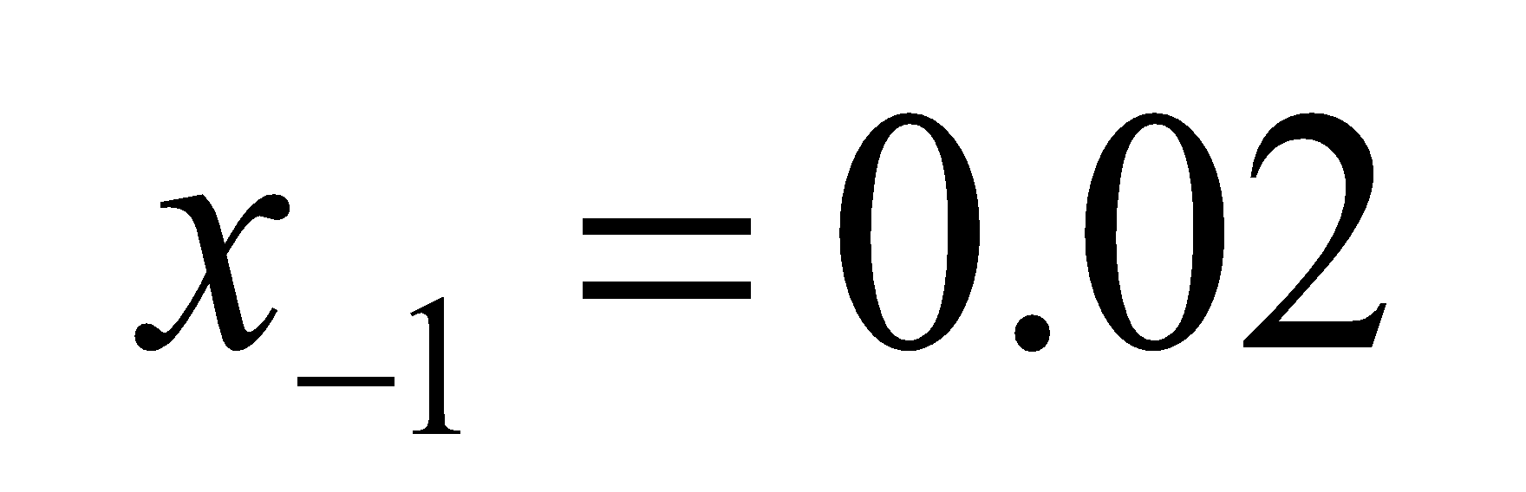
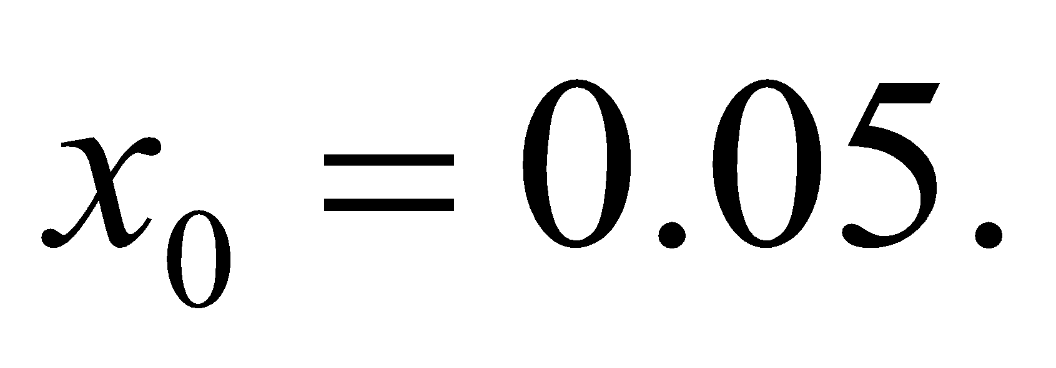
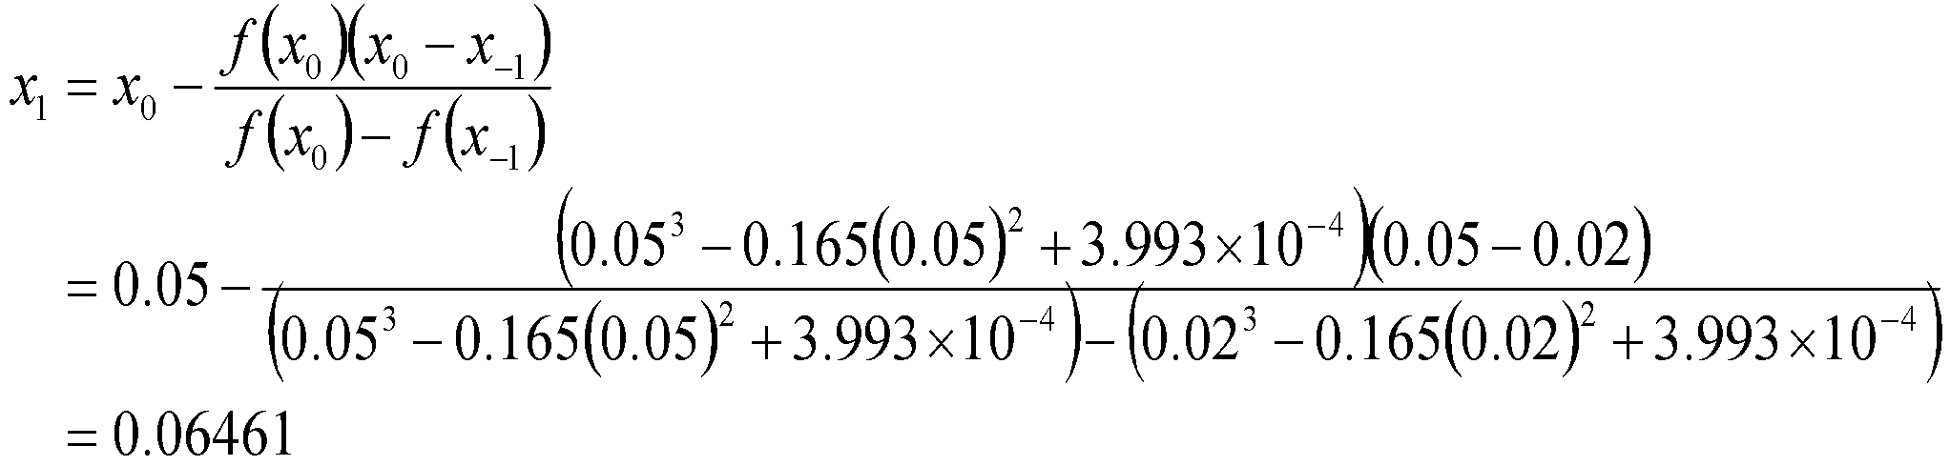
Example 1 Cont.
Let us assume the initial guesses of the root of
as and
Iteration 1
The estimate of the root is
‹#›

Slide 11
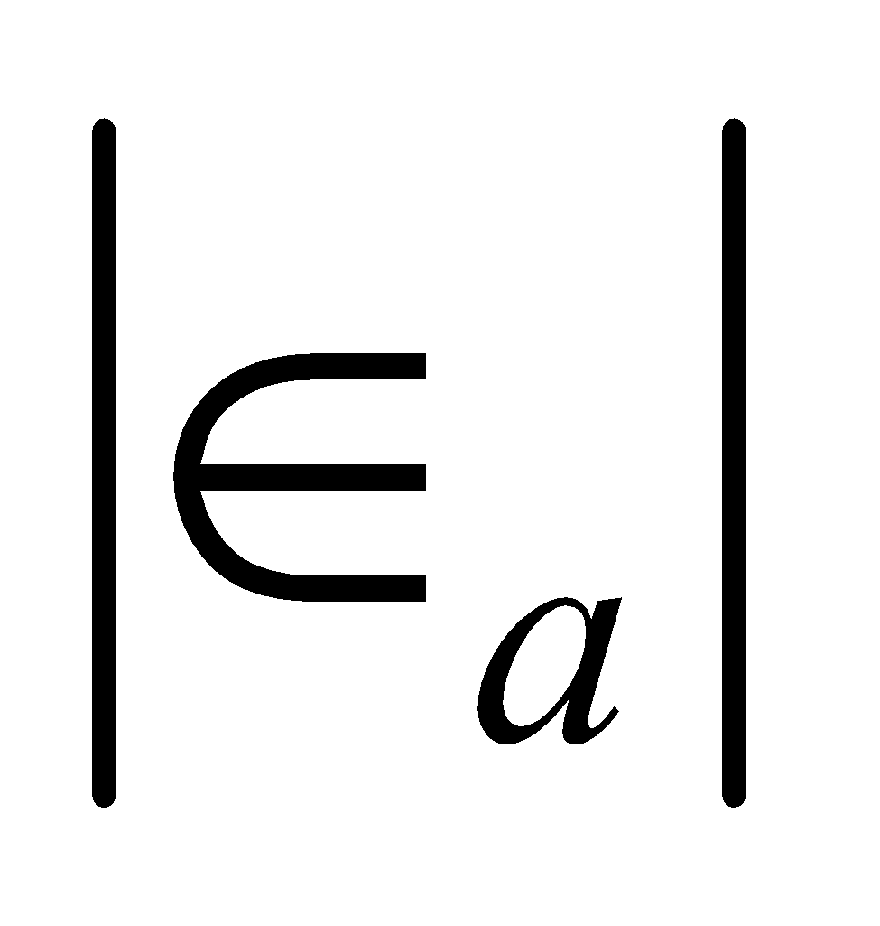
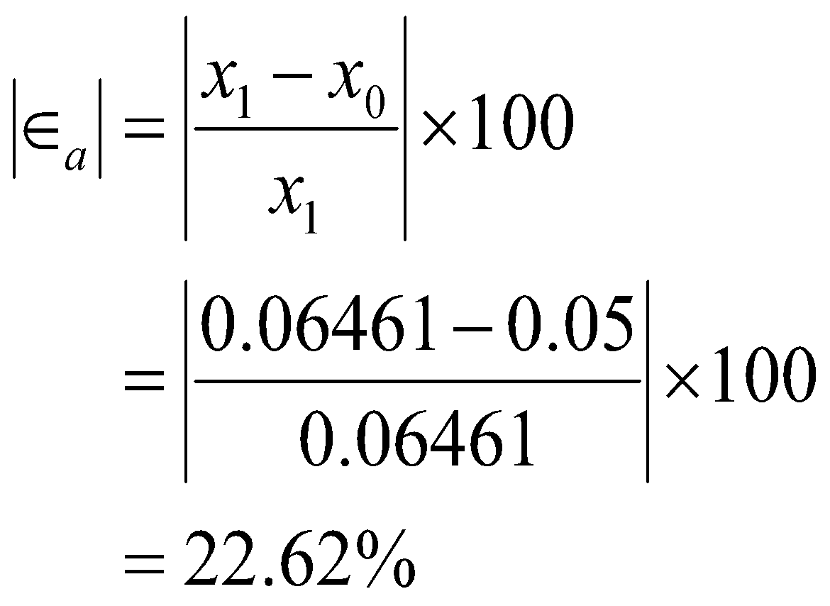
Example 1 Cont.
The absolute relative approximate error at the end of Iteration 1 is
The number of significant digits at least correct is 0, as you need an absolute relative approximate error of 5% or less for one significant digits to be correct in your result.
‹#›

Slide 12
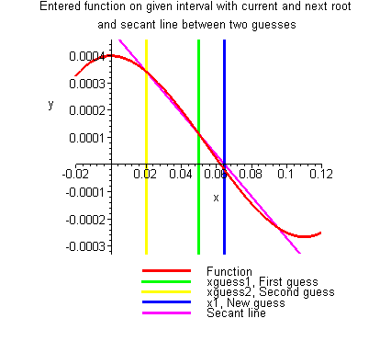
Example 1 Cont.
Figure 5 Graph of results of Iteration 1.
‹#›

Slide 13
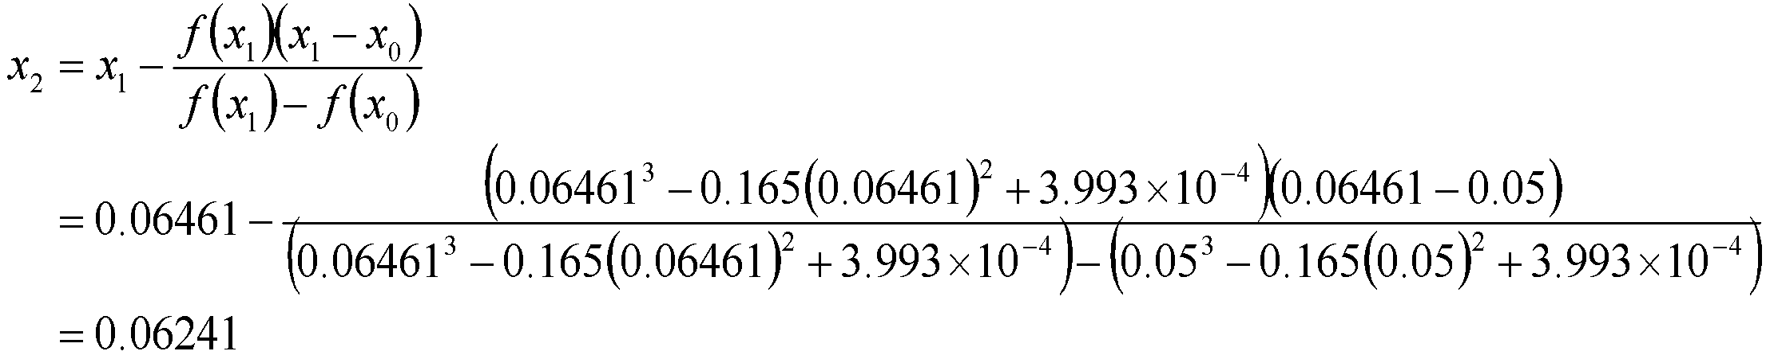
Example 1 Cont.
Iteration 2
The estimate of the root is
‹#›

Slide 14
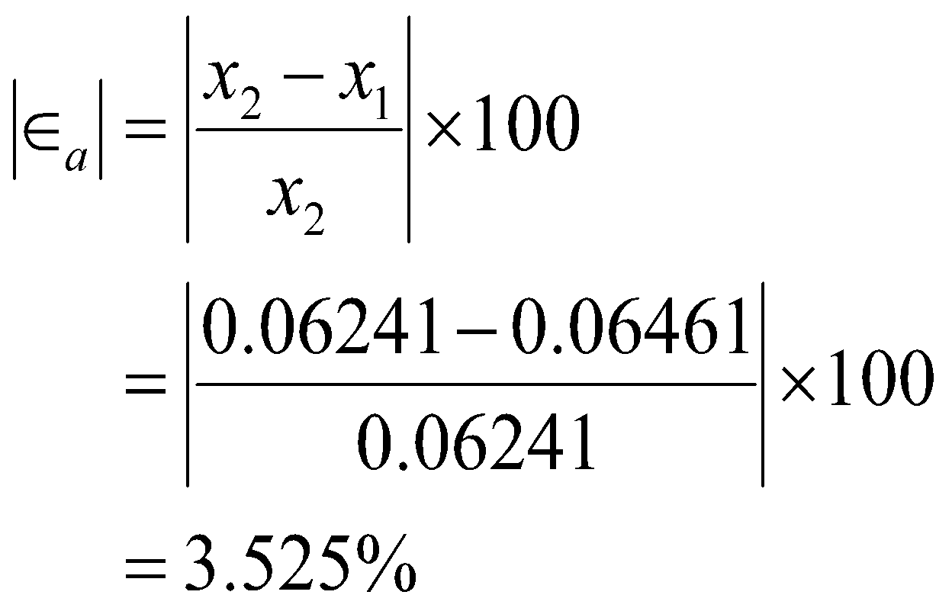
Example 1 Cont.
The absolute relative approximate error at the end of Iteration 2 is
The number of significant digits at least correct is 1, as you need an absolute relative approximate error of 5% or less.
‹#›

Slide 15
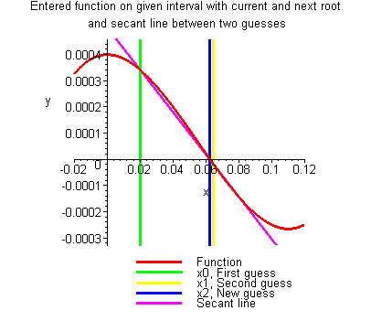
Example 1 Cont.
Figure 6 Graph of results of Iteration 2.
‹#›

Slide 16
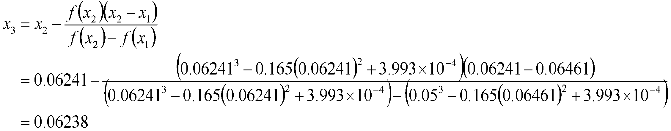
Example 1 Cont.
Iteration 3
The estimate of the root is
‹#›

Slide 17
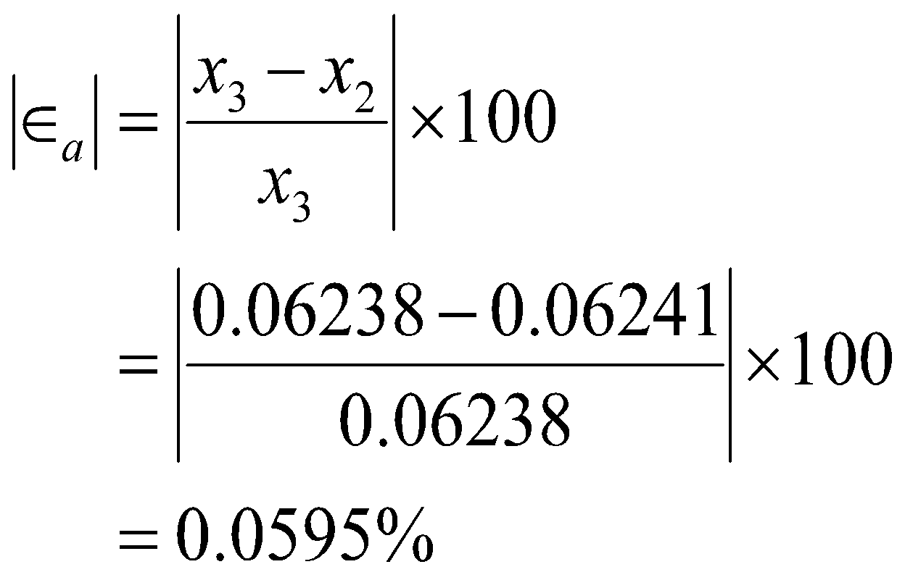
Example 1 Cont.
The absolute relative approximate error at the end of Iteration 3 is
The number of significant digits at least correct is 2, as you need an absolute relative approximate error of 5% or less.
‹#›

Slide 18
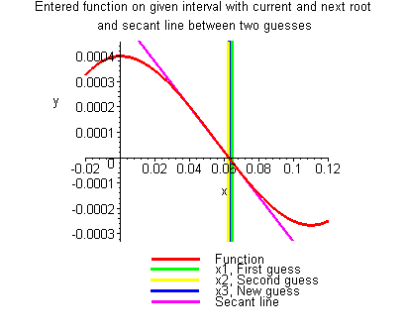
Iteration #3
Figure 7 Graph of results of Iteration 3.
‹#›

Slide 19
Advantages
Converges fast, if it converges
Requires two guesses that do not need to bracket the root
‹#›

Slide 20
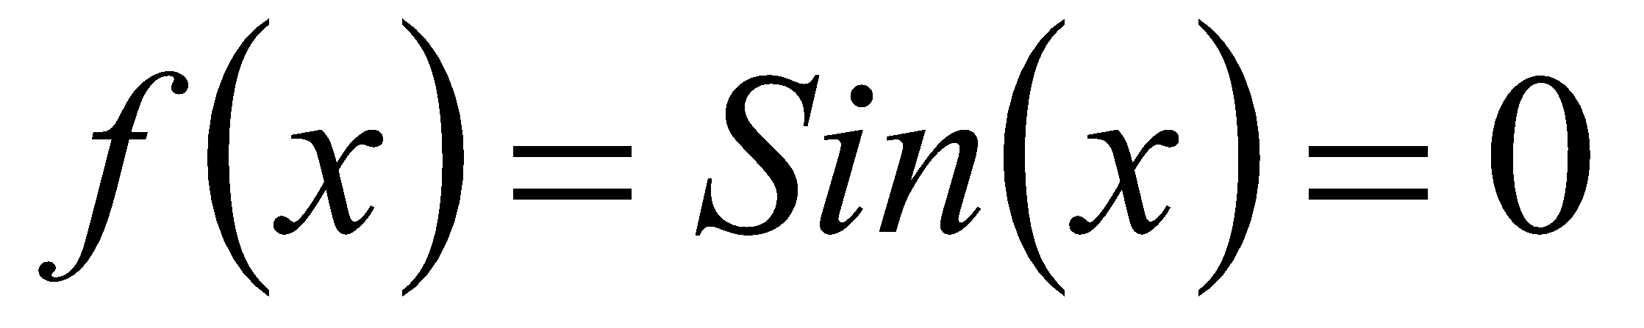
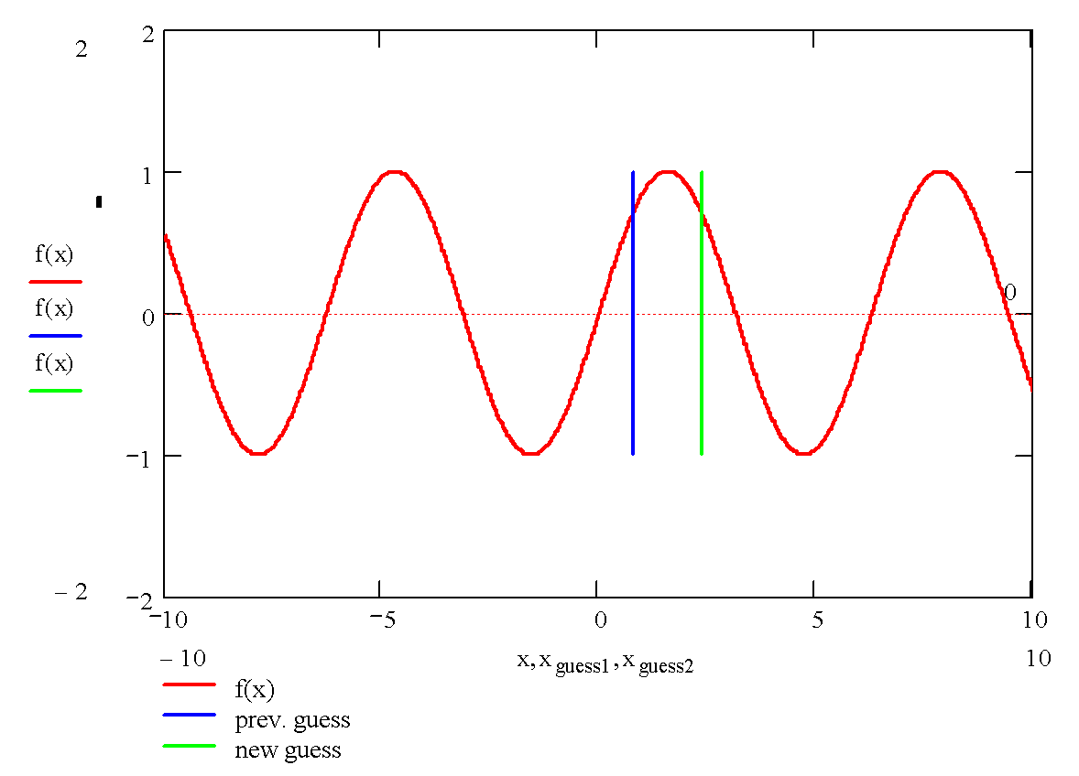
Drawbacks
Division by zero
‹#›

Slide 21
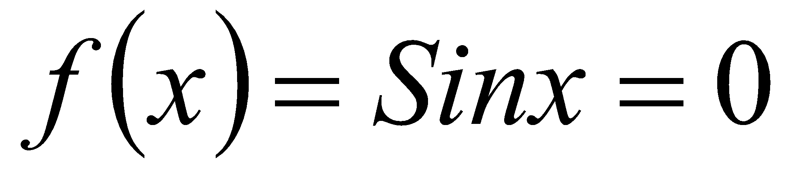
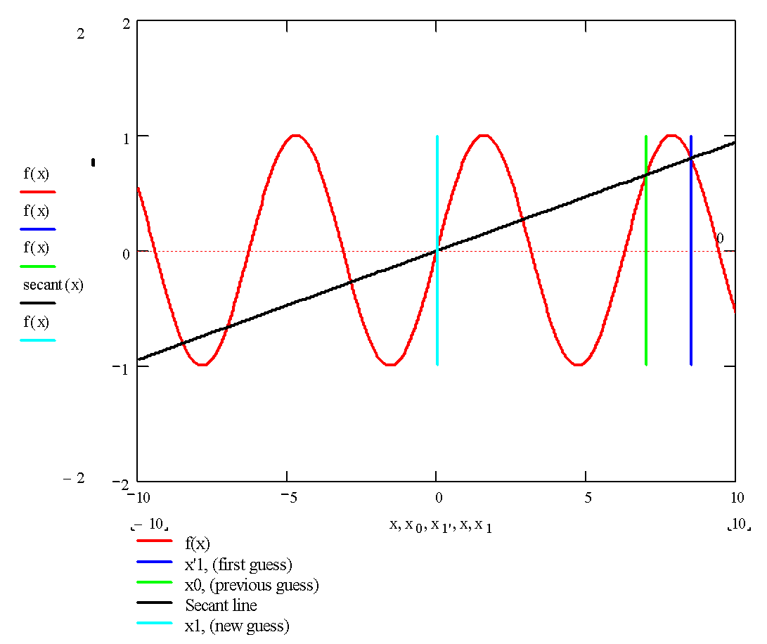
Drawbacks (continued)
Root Jumping
‹#›

Slide 22
THE END
Notes:
‹#›

